Slide 1
Window Replacement Project Information Session
Presentation to Barclay Owners
November 21, 2013

Slide 2
Introduction: exp Services
Exp is one of the industry leaders in building engineering services, and has extensive experience in feasibility studies, facility condition assessments, technical audits, reserve fund studies, third party design reviews, and quality assurance during construction. We provide multi-disciplinary engineering and problem solving services to the highest professional standard and meet our clients’ needs through workable solutions and responsive communication.
Ms. Chantal Wegner, M.A.Sc., P.Eng. – Division Manager, Building Engineering Services – I have over 19 years of building engineering experience and extensive experience in the consulting engineering and construction industries (encompassing structural and building envelope component assessments, such as windows and building rehabilitation). I have also been preforming Reserve Fund Studies for over 19 years.
2

Slide 3
Introduction
This presentation is in response to a petition received by the Board on September 20, 2013
The petition had three requests:
  Rescind the special assessment
  Implement a maintenance and repair program to extend the life of the windows and doors
  Contract for the immediate re-caulking of all windows of the Barclay at no additional cost
3

Slide 4
Introduction
This presentation will review in more detail the possibility of implementing a maintenance and repair program to extend the life of the sliding glass doors and fixed windows
Answer questions
4

Slide 5
Background: exp August Presentation
Prior to the exp August presentation 7 condo units, the party room and swimming pool were examine and it was concluded that:
  Sliding glass doors are in need of replacement within 2 years
  Replacement of fixed windows, with repair and maintenance, could be delayed 5 to 7 (no later than 2022)
  However, the recommendation was that both sliding glass doors and fixed window assemblies should be replaced together no later than 2017 to obtain a better seal between window units, better installation, reduce costs and reduced disruption to owners
5

Slide 6
Background: Selection Criteria
It is important to understand the basis for selecting the units to be examined:
  Exp requested that windows and sliding doors with problems and without problems be randomly chosen.
  Suites were chosen from all elevations and at different heights within the building.
6

Slide 7
Background: October 2013 Exp Study
In October 2013, the board asked exp to re-examine the possibility of doing the project in two phases although this is not the recommendation:
  Phase 1: Replace sliding glass doors in 2017
  Phase 2: Repair and maintain, thereby extending the life of the fixed windows for an additional 9 years until replacement in 2022
Exp completed additional site visits with a glass window contractor and assessed 3 additional condo units for a total of 10 (11% of total units).
Exp then compared the costing analysis results with the original study that recommended replacing both sliding and fixed windows in 2017.
7

Slide 8
Assumptions
The assumptions used for the October Study are the following:
  Full re-caulking of the windows and doors in 2014: $80,000
  Replace sliding glass doors in 2017
  Repair of sliding glass doors and replacement of damaged and fogged fixed windows units as they occur until 2017: $2,000/year; and $5,000/year between 2018 and 2022
  Replace fixed windows in 2022 (in 9 years)
  All other assumptions (interest rate, professional fees, inflation rate etc.) remain the same
8

Slide 9
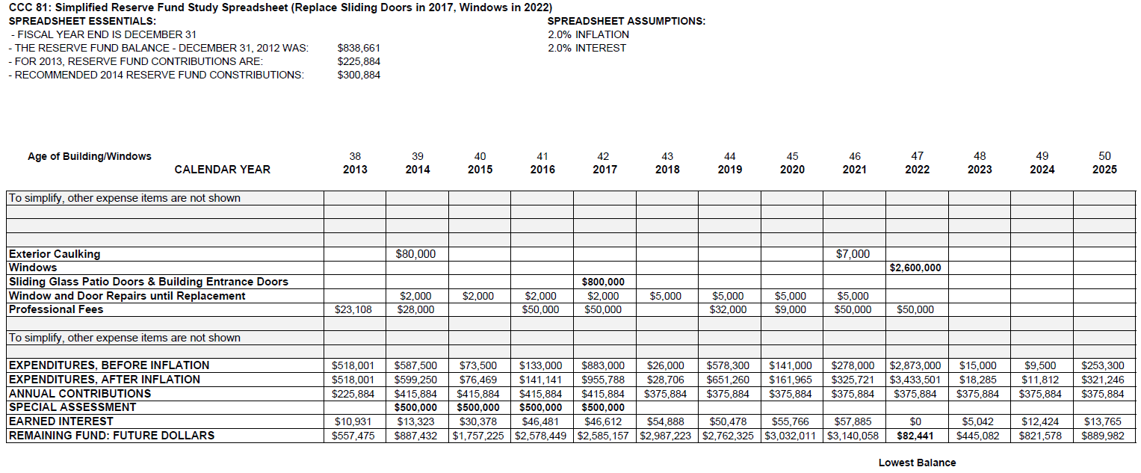
Results
Replace Sliding Doors in 2017, Delay Window Replacement to 2022
9

Slide 10
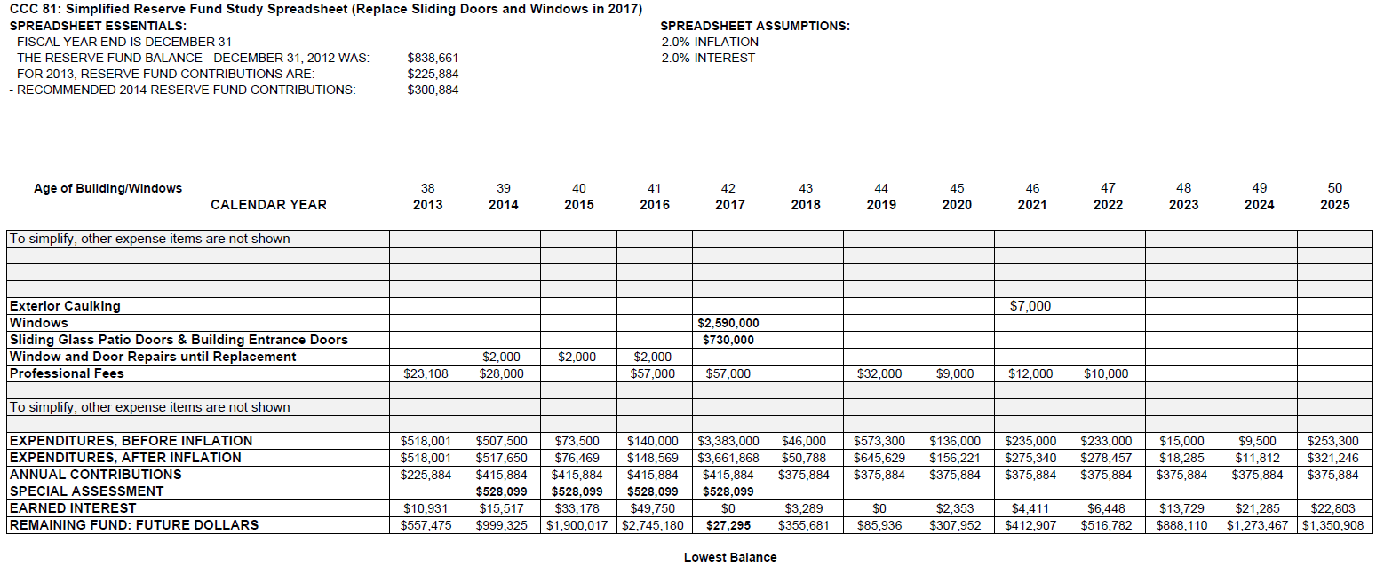
Results
Replace Sliding Doors and Windows in 2017
10

Slide 11
Results
By delaying the window replacement
Over 4 years the overall special assessment would be reduced by $112,400 from $2,112,400 to $2,000,000 (5.3%)
The total yearly special assessment would be reduced by $28,100 from $528,100 to $500,000 (5.3%)
The average yearly special assessment for owners would be reduced from $5,618 to $5,319 (5.3%)
11

Slide 12
Analysis
If we delay replacement of the fixed windows until 2022, we have seen that the corporation saves $28,100 per year (5.3%) or $112,400 over 4 years
However by delaying replacement of the fixed windows, the corporation forgoes the reduction in energy costs for the 5 years until new fixed windows are installed (2018-2022)
12

Slide 13
Analysis
The industry standard for energy savings relating to new windows is approximately 10%
The 2014 energy cost for all hydro and gas at the Barclay is estimated at $337,000. We need to adjust downward to reflect that new windows will reduce heating and A/C costs only. The adjusted figure for heating and A/C alone is estimated at $200,000 per year post 2017
13

Slide 14
Analysis
The corporation would be forgoing an estimated energy savings from 2018 to 2022 of $200,000 X 10% x 5 years = $100,000
So although the special assessment could be reduced by a repair and maintenance program, by $112,400 from 2014 to 2017, our operating costs from 2018 to 2022 will not be reduced by the estimated $100,000 and may well increase with projected increases to gas and hydro
Therefore, potential total savings would be reduced to approximately $12,400 ($112,400 – $100,000 = $12,400) over 9 years, or on average approximately $15 per unit per year
Still to consider:
  Owners will be disrupted twice instead of once; disruption means taking down curtains and headers twice; concrete work twice; entry into apartments and displacing furniture twice; drywall repairs, impact on resale value and appearance; and savings over 4 years will be minimal.
14

Slide 15
Analysis
Beyond the results, a second consideration is the 1998 Condominium Act legislation:
Condo boards must ensure that by 2018, the Reserve Fund be “adequate”
“Adequate funding” is generally taken to mean that the annual Reserve Fund contribution should remain the same from year to year except for adjustment for inflation and there be no special assessments for known repair and replacement projects, while keeping the balance positive
15

Slide 16
Analysis
Since there is currently a shortfall in the Reserve Fund, that shortfall must be corrected by 2018 irrespective of whether the windows and doors are replaced together in 2017 or split and fixed windows delayed until 2022
16

Slide 17
Conclusion
If according to the Act, the Corporation must fund the replacement of all sliding doors and fixed windows by 2018, and without reasonable expectations of significant savings, the project must realistically and legally proceed as soon as possible
Consequently, contributions need to start in January 2014, in order for the special assessment to be spread over 4 years rather than 3, or 2 or 1 which would make the yearly special assessment that much bigger.
17

