Slide 1
The History of the English Language
http://www.slmc.uottawa.ca/?q=english_history#s1

Slide 2
What is Indo European? ()
The largest English language family from which most languages originated;
It was NEVER written or recorded;
It was spoken over 5000 years ago by tribes who wandered through areas stretching from Europe to India; The ultimate origins of English lie in Indo-European, a family of languages consisting of most of the languages of Europe as well as those of Iran, the Indian subcontinent, and other parts of Asia.
Over time, many tribes migrated to other parts of the world, leaving behind the original language and developing our current language
Result of this migration? Many different dialects…

Slide 3
What is Germanic ? ()
Original Indo-European language speakers;
Several dialects developed from this language, one of which eventually became the English language

Slide 4
Old English – 450-1100
Before the first century B.C.E. (Before the Common Era) England was inhabited by the Celts (few words remain from the Celts- mostly place names: Kent, Cumberland, Thames)
Caesar invaded parts of England in 55 BCE why?
Romans invaded again in 43 AD and settled – controlled England for more than 400 years, but never fully controlled the Celts

Slide 5
Old English – 450-1100 Germanic Invasions of England zach
410 The Goths (speakers of a now extinct East Germanic language) sack Rome. The first Germanic tribes arrive in Britain. Gothic is the language of the earliest literary documents of the Germanic peoples as a whole. The only linguistic remnants of Germanic peoples which antedate Gothic remains are some of the Runic inscriptions
Early 5th century With the collapse of the empire, Romans withdraw from Britain but then Britons are attacked by the Picts and by Scots. Angles, Saxons, and other Germanic settlers arrive in Britain to assist the Britons and claim territory….but they turn against their allies
5th-6th centuries Germanic peoples (Angles, Saxons, Jutes, Frisians) speaking West Germanic dialects settle most of Britain. Celts retreat to distant areas of Britain: Ireland, Scotland, Wales(on northwest coast of France)
Roman, Celtic, and Christian culture displaced from England.

Slide 6
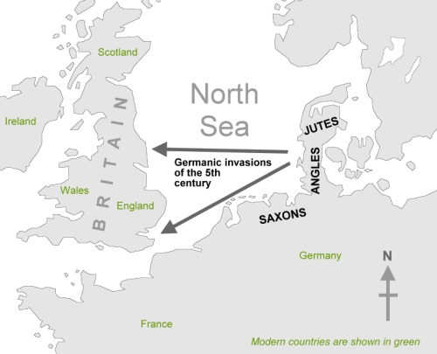
Anglo Saxon or Old English language is the result of these Germanic invasions.

Slide 7
Angelcynn??
Anglo-Saxons were in control of Britain by sixth century; land renamed "England" (i.e. Angle-lond > Engla-lond, "land of the Angles"), and the people "English" (i.e. Angles > Anglisc)
The name England comes from Angles – people were called ‘Angelcynn’ (people of the angels) which then became Englaland (land of the angels).
Words still existing form this period include house, woman, farm, man and love.

Slide 8
What is Beowulf?
The Old English language was mostly spoken, but it did have highly developed poetry and prose; the most famous of course, being the epic ballad of: BEOWULF
Beowulf: the earliest known recorded (written around 8th century) epic ballad. Since the poem takes place in Scandinavia, it provides some information about customs and traditions of the people of this time and place:
http://faculty.virginia.edu/OldEnglish/Beowulf.Readings/Prologue.html

Slide 9
Beowulf- not on handout
Unknown date of composition (roughly 8th-11th Century CE) around 700 A.D.
The story had been in circulation as an oral narrative for many years before it was written.
The action of the poem takes place around 500 AD
Poet is reviving the heroic language, style and values and pagan values of ancient Germanic oral poetry
Unknown author; possibly one Christian author in Anglo-Saxon England

Slide 10
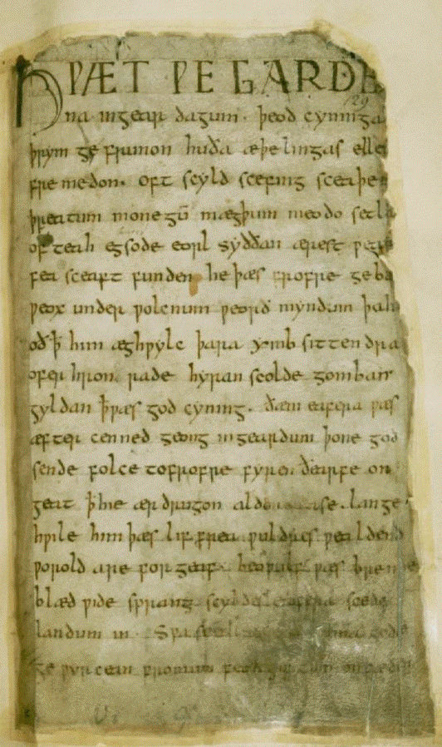
Beowulf cont….
Only a single manuscript of the poem survived the Anglo-Saxon era. In the 1700’s it was nearly destroyed in a fire
It was not until 1936 when the Oxford scholar J.R.R Tolkien published a paper on the poem that it became popular.

Slide 11
Anglo-Saxon Futhorc
Old English / Anglo-Saxon was sometimes written with a version of the Runic alphabet, brought to Britain by the Anglo-Saxons until about the 11th century (1OOO’S).
Runic inscriptions are mostly found on jewellery, weapons, stones and other objects. Very few examples of Runic writing on manuscripts have survived.

Slide 12
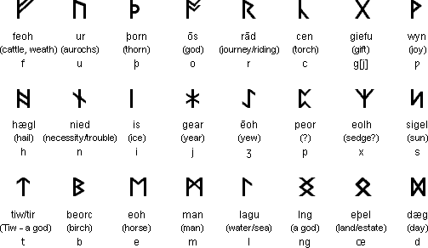
These symbols could represent both sounds and ideas

Slide 13
Old English Language-
Only 1/5th of the modern English vocabulary is derived from Old English;
The vocabulary, spelling and grammar were all different at this time.

Slide 14
Old English alphabet:
http://www.omniglot.com/writing/oldenglish.htm
http://www.omniglot.com/writing/oldenglish.htm

Slide 15
Take particular note of these features in the Old English Alphabet (not on your handout):
the rounded shape of d;
the f that extends below the baseline instead of sitting on top of it;
the dotless i;
the r that extends below the baseline;
the three shapes of s, of which the first two (the Insular long s and the high s,) are most common;
the t that does not extend above the cross-stroke;
the ƿ ("wynn"), usually transliterated as w
the y, usually dotted, which comes in several different shapes.

Slide 16
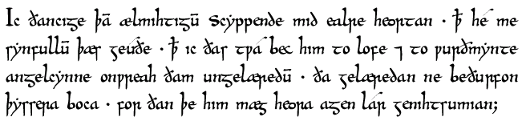
Any idea what this might say?
I thank the almighty Creator with all my heart that he has granted to me, a sinful one, that I have, in praise and worship of him, revealed these two books to the unlearned English nation; the learned have no need of these books because their own learning can suffice for them.

Slide 17
More development
In the year 597, St Augustine and his monks arrived, introducing Latin words because monks were converting the English to Christianity (which was largely recorded in Latin). Therefore, most of the words remaining from this time are associated with religion:
candle,
angel,
wine, etc.

Slide 18
More development
In the eight and ninth centuries, the Vikings invaded Britain. Danish Kings actually held the British throne for 25 years!
When Vikings (who spoke Old Norse) started to marry Anglo-Saxons, their Old Norse language was mostly droppped and they began to speak the language of the Anglo-Saxons.
some of the Norse words remain to this day–sky, egg, cake, get, give, die

Slide 19
Defining Characteristics of Old English
http://pages.towson.edu/duncan/IELanguageTree.htm
Old English contained many inflections which are word endings or additions for verbs, nouns + adjectives that indicate grammatical relationships (verb tense, person, gender, number or case…similar to French) (drinken instead of drink, eaten instead of eat)
When people began to read and write the language, they borrowed the Roman alphabet and spelled words phonetically.

Slide 20
Borrowings in Old English
This whole issue of word origins is very difficult as Latin, the Germanic tongues, Old English (derived from Germanic), and the Celtic tongues are all ultimately derived from a common Indo-European root, and are cognates (related). This can easily be demonstrated by looking (for example) at the words I, me, is, brother, ten.

Slide 21
English I me is mother brother ten
Sanskrit aham ma asti matar bhratar daca
Iranian azem me asti matar bratar dasa
Greek ego me esti meter phrater deka
Latin ego me est mater frater decem
Old English ic me is moder brothor tien
Old Irish me is mathir brathir deich
Lithuanian asz mi esti mote broterelis deszimtis
Russian ia menya jest' mat' brat' desiat'

Slide 22
MAJOR CHANGES FROM OE TO ME:
OE symbols such as the letter "ð", are gone
Alphabet looks more like the modern one
Endings that showed word relationships are gone (eaten, drincan)
Word order is more like Present Day English
Plenty of new words with French origin

Slide 23
Middle English Defining characteristics 1100-1450
popular traditions are being recorded (eg the ballad)
beginnings of recorded drama – usually based on morality plays, or ‘miracle’ plays
Courtly tradition – imitate the Italians and the French! – romance is all the rage…
French influence on language – to be anyone, you have to speak French…
Geoffrey Chaucer The Canterbury Tales Chaucer intro video
http://www.youtube.com/watch?v=uxqAwT5IpL8
First complete translation of the Bible
Thomas Malory Le Morte Darthur -qualities of chivalry, romance = the perfect knight and gentleman

Slide 24
Middle English cont….
THE NORMANS INVADE ENGLAND!!! (Speaking French)
1066, William the Conqueror from Normandy successfully invades England.
Top levels of English-speaking political and ecclesiastical hierarchies were removed
This was the greatest historical influence on the Middle English language.
Results:
For 2 centuries, French was the official language of England.
By the end of the fourteenth century, English was once again the language of England, but it had changed drastically.

Slide 25
Middle English cont….
English was still spoken by the natives, while French was spoken by the upper classes and the courts.
As a result, many French words became part of the Middle English every day language…10 000 words were added to the English language from the Normans.
Since the Normans were the rulers, most words had to do with that authority, (castle, prison, court)
This is why many times our current language has two entirely different words which mean the exact same thing – one word is of OE origin, while the other is of Norman origin:
OE French
Smell Odour
Ask Request
Yearly Annual
Most words with only one syllable have an Old English origin because the ‘language of the masses’ came to be English. More complicated words of two syllables or more were used primarily by the upper classes and usually had French or Latin origins, but common words used by the masses had only one syllable.

Slide 26
Medieval Religious Pilgrimmages
Pilgrimages are nothing new. For thousands of years, people have travelled to various religious sites for different reasons. However, there was never a more popular time for religious pilgrimages than during the Middle Ages.
In medieval times, people made long trips to visit the relics or resting places of revered saints. Many of these journeys, to far away places such as Jerusalem or Rome, could take months and often, the travellers never returned, such were the risks of travelling to an unknown destination.
Why did medieval people go on pilgrimage? Obviously, for the majority of people, there were religious reasons for their trip. Many believed their successful journey to a chosen shrine would secure them a place in heaven.
Others, like some modern-day pilgrims, sought a cure from illness or, failing that, personal peace and solace. And some went to a shrine as an act of thanksgiving or atonement, or to make a special request of the saint associated with the site. A pilgrimage could also be imposed by a member of the clergy, in order to punish a penitent.
A pilgrimage was often one of the only chances for people from all walks of life to really associate with each other.

Slide 27
MODERN RELIGIOUS RELICS?
top 10: http://www.youtube.com/watch?v=TKCx7ZZko-w
weeping mary, Ontario: http://www.youtube.com/watch?v=DSpJ8kVpAF0
how to: http://www.religioustolerance.org/chr_stat.htm

Slide 28
Modern English 1450 – Onwards WHO IS WILLIAM CAXTON? -
Caxton was the first English printer and a translator and importer of books into England
In the early 1470s Caxton spent time in Cologne learning the art of printing. He returned to Bruges in 1472 where he and Colard Mansion, a Flemish calligrapher, set up a press.
In 1476 Caxton returned to London and established a press at Westminster, the first printing press in England. Amongst the books he printed were Chaucer's 'Canterbury Tales', Gower's 'Confession Amantis' and Malory's 'Le Morte d'Arthur'. He printed more than 100 books in his lifetime

Slide 29
Modern English
When Henry Tudor took the British throne, the modern age began. He and Elizabeth I began England’s first explorations, resulting in the empire-building of England, and of course, the spread of the English Language.
Eventually, words were added to the English Language from these mass explorations and empire building. Most words had to do with trade, exploration and colonization.
IE:
Tea (from China)
Bungalow, cot (from India)
Tomato, chocolate (from Central and South America)
Hurricane (from the Caribbean)

Slide 30
Renaissance 1485-1660
-time of great achievements/advancements, a ‘rebirth’ or flowering of interest in academia
the power of literature, of the written word itself, is discovered, and flourishes
-the printing press – a revolutionary invention – and its effect on spelling, literature, even the spoken language
William Shakespeare, Edmund Spenser, John Milton
-struggles in religion – Reformation and the division of the Roman Catholic Church
-the flowering of the poetic form, the sonnet
bringing “mysteries” within the knowledge and grasp of all people – the possibilities seem endless!

Slide 31
Enlightenment 1660-1780
“the irregular combinations of fanciful invention may delight awhile, but the pleasures of sudden wonder are soon exhausted, and the mind can only repose on the stability of the
truth” Samuel Johnson Alexander Pope, Jonathan Swift , John Dryden
Science Rules! Truth and Logic Forever!
Knowledge and Learning are seen as the greatest source of order, the epitomy of civilized behaviour.
Enlightened people = free from ignorance and superstition
Believed most problems in human existence could be solved by reason, and by learning
Beginning of rules of grammar - 1st dictionary is developed/written by Samuel Johnson
Spoken and written English are now seen as having certain standards of correctness
“the faculty of the imagination is supported/enriched by the faculty of judgement”
growing/rising middle class who want to acquire the trappings of ‘correctness’ and feel they need to know the ‘rules’ of speaking, writing correctly
Mrs. Malaprop – “malapropism”
New orderliness in society – post office, newspapers, banks, growing bureaucracy, etc.

Slide 32
The Romantic period 1780-1830 ()
“the faculty of imagination takes over the power of judgement”
wild, extravagant, visionary, fanciful, idealized, sentimental, fantastical, grandeur, picturesque…
looked at nature with a new sensitivity, freshness
William Wordsworth, John Keats, Samuel Taylor Coleridge, Jane Austen, Mary Wollstonecraft Shelley
The individual perception of truth is what matters
Writer’s sense of closeness to the subject, revealed by the power of his/her imagination
Dreams of freedom – REVOLUTION – emancipation, liberty, equality…
New impulses in thought and expression – feeling of freedom and “brotherhood of all men”
Way too prolific use of the word “soul” in poetry!

